Slide 1
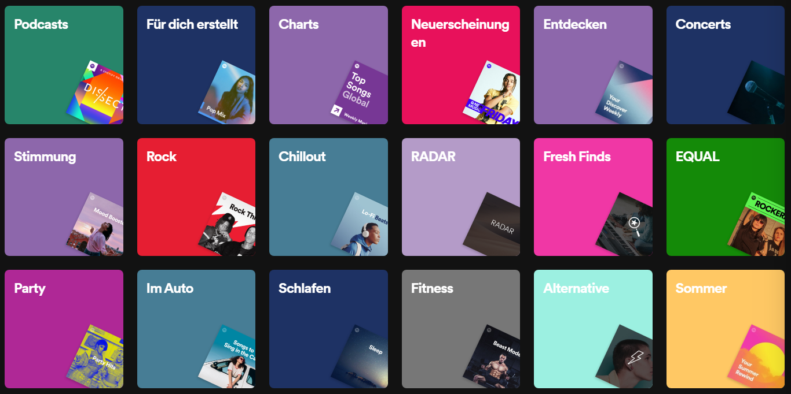


Music recommendation system
Team Members:-
BL.EN.U4CSE20097 - MaramPreetham BL.EN.U4CSE20135 - Putluru Vishnu
BL.EN.U4CSE20130 - Praveen Sai R B

Slide 2
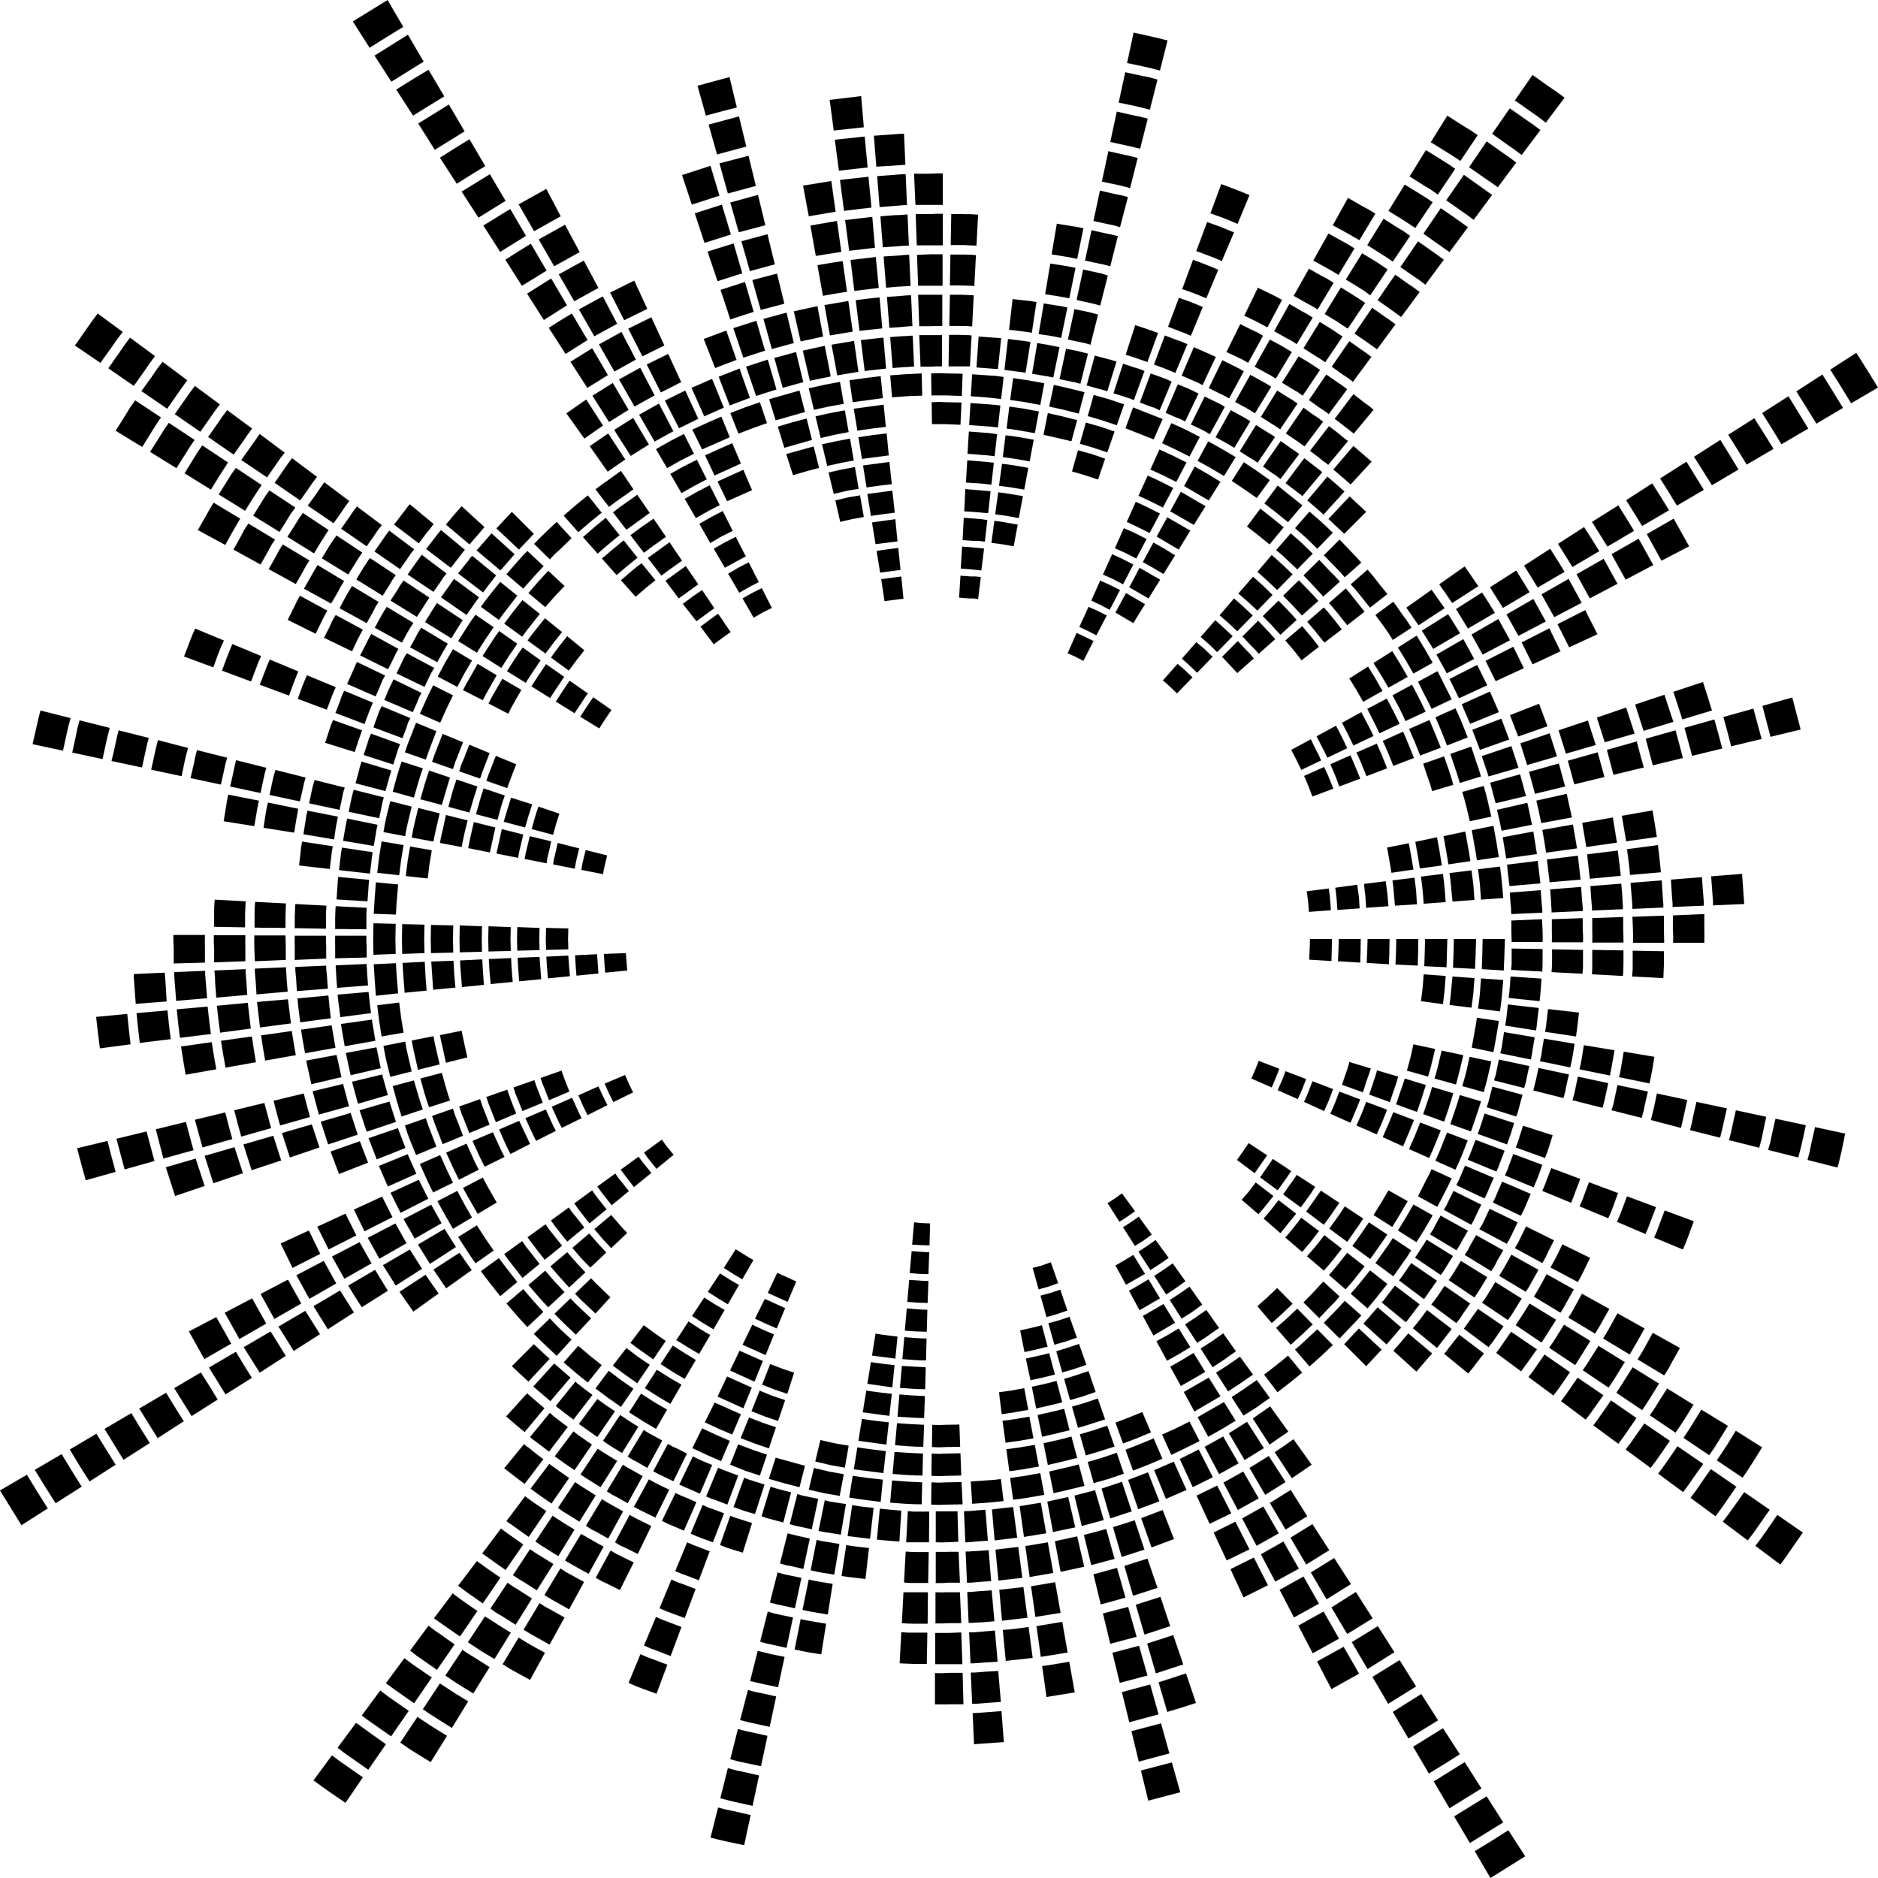



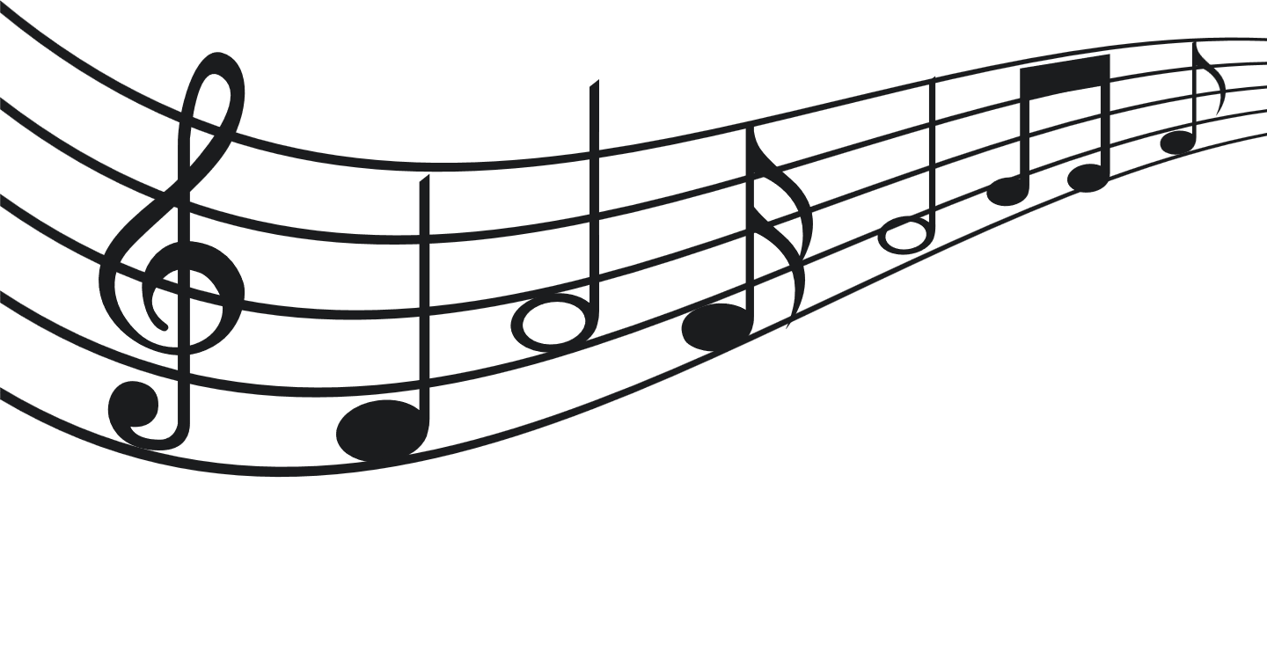


INTRODUCTION
Imagine you love music and have a vast collection of songs. However, finding new songs that match your taste can be challenging.
This code aims to make that process easier. It takes a large dataset containing information about various songs, such as their rhythm, energy, and genre.
The goal is to group similar songs together and understand the patterns in the music. By doing this, the code can recommend new songs to you based on what you already enjoy.

Slide 3
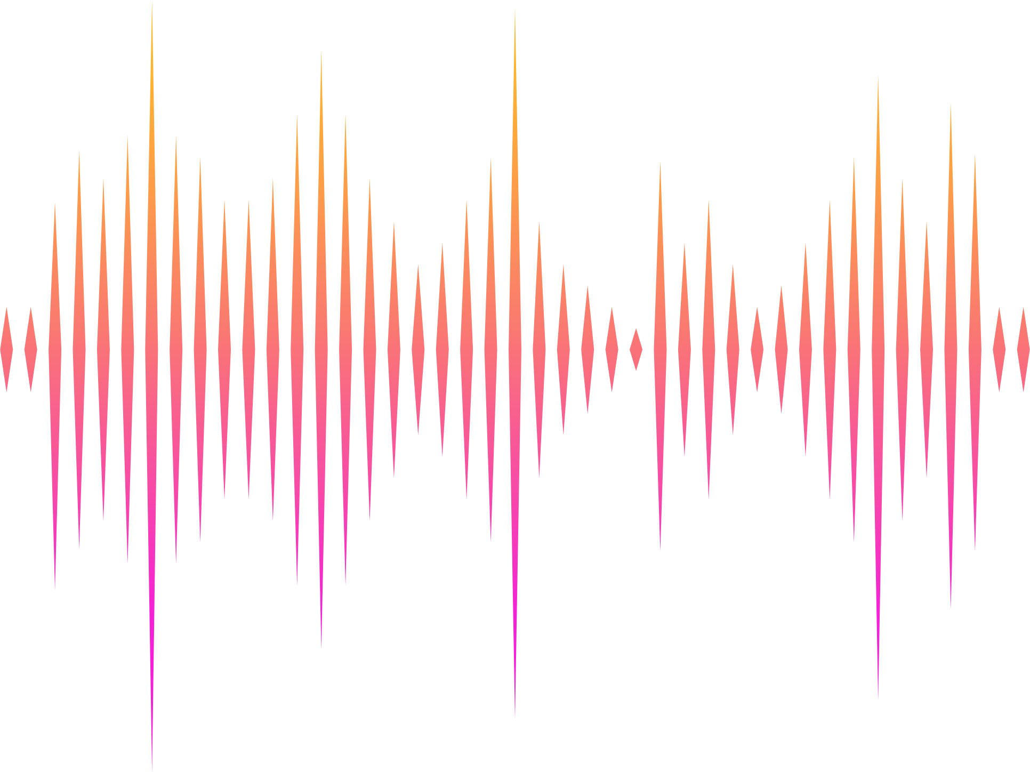



Continued..
Music recommendation systems are essential for platforms like streaming services to enhance user experience.
Clustering similar songs allows for personalized recommendations, making it more likely that users will discover and enjoy new music.
Analyzing the distribution of music genres provides valuable information about the popularity of different genres.

Slide 4


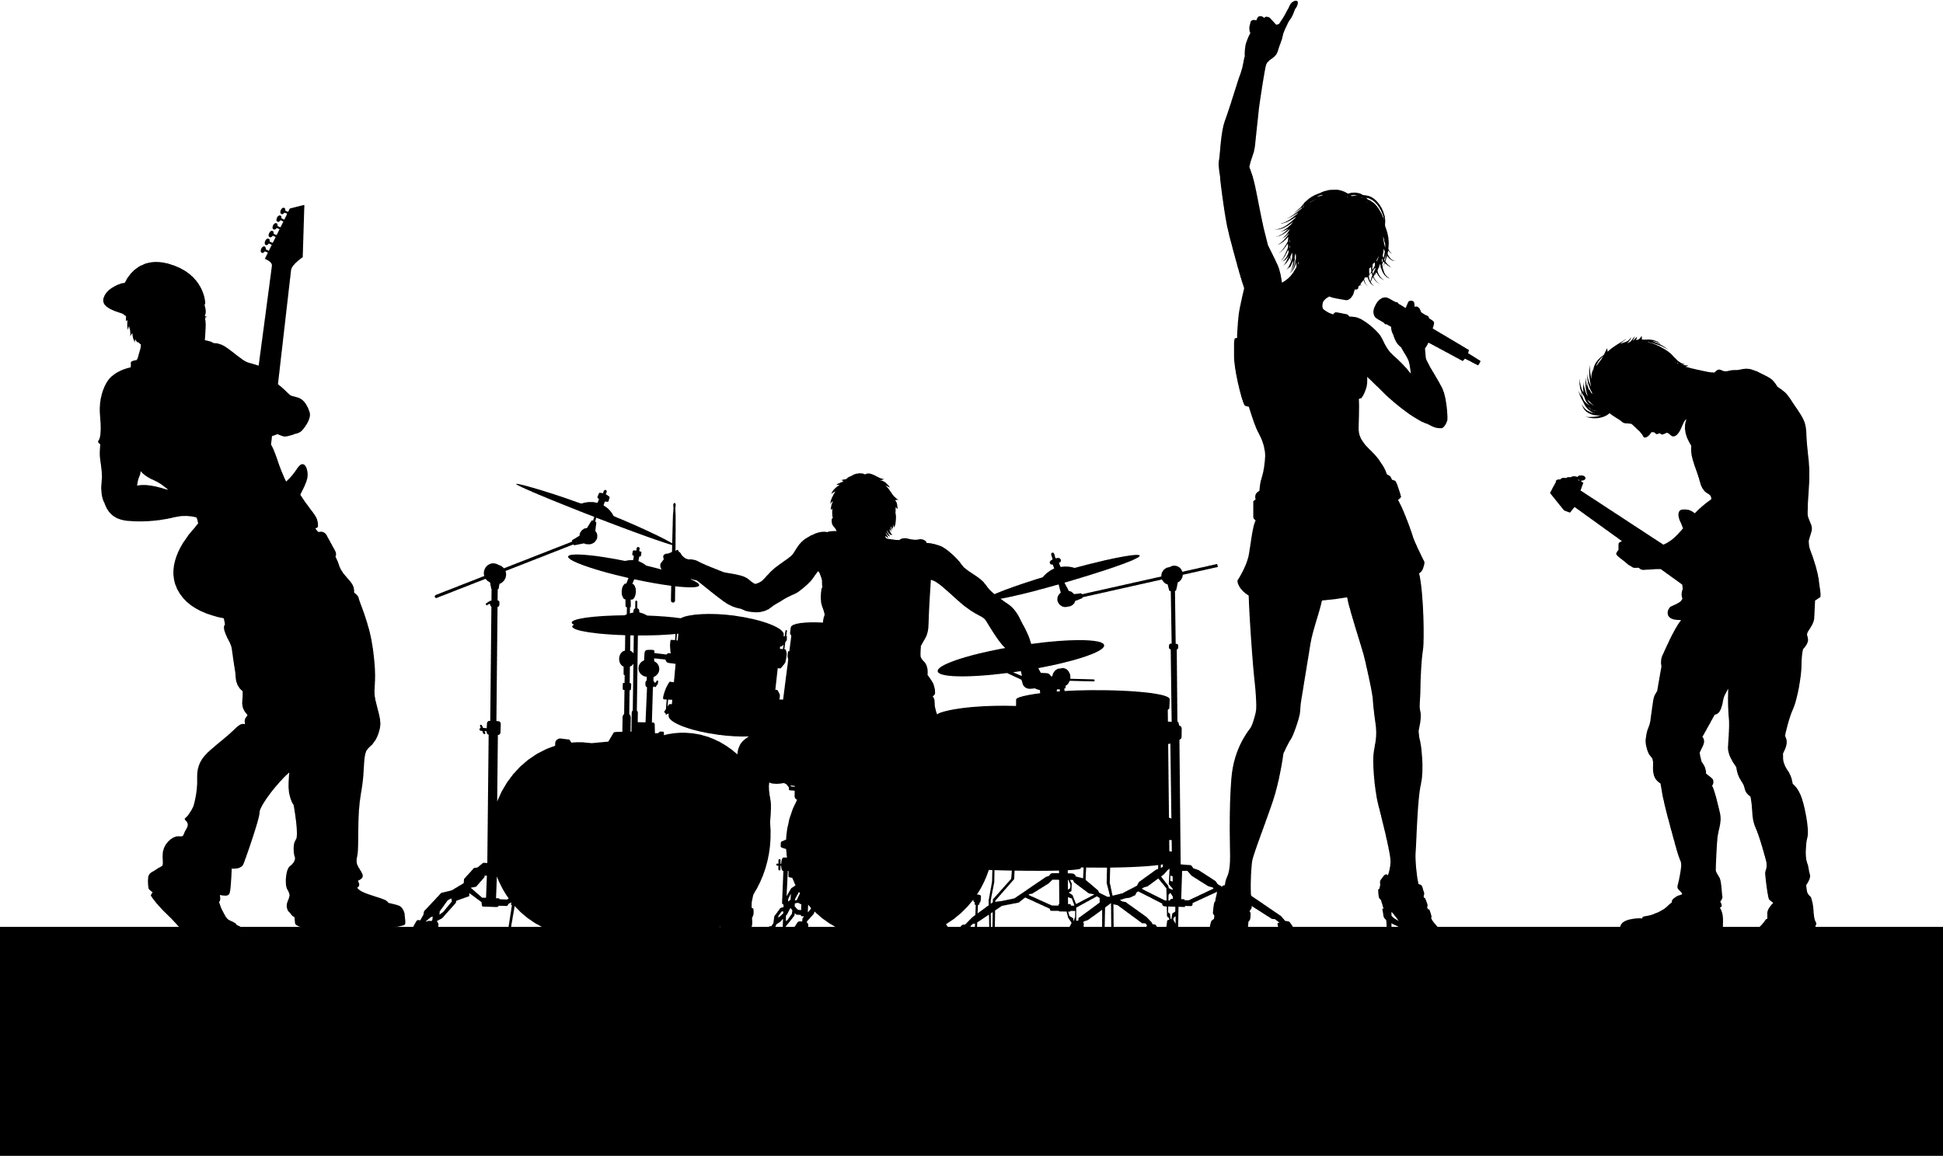
PROBLEM DEFINITION
"Create a music recommendation system that makes use of dataset attributes like danceability, energy, and liveliness to propose songs based on user tastes.”

Slide 5






CHALLENGES
Ensuring the clustering method accurately captures meaningful groups of songs is also important.
Dealing with missing data in the dataset could be a challenge.
Additionally, determining the right number of song clusters is a common challenge.
Missing values in the dataset may pose challenges during data preprocessing.
Selecting an appropriate number of clusters (k) for k-means is a common challenge in clustering tasks. The code uses the elbow method and silhouette scores to address this.
Interpreting and validating the clusters to ensure they capture meaningful patterns in the data can be challenging.

Slide 6

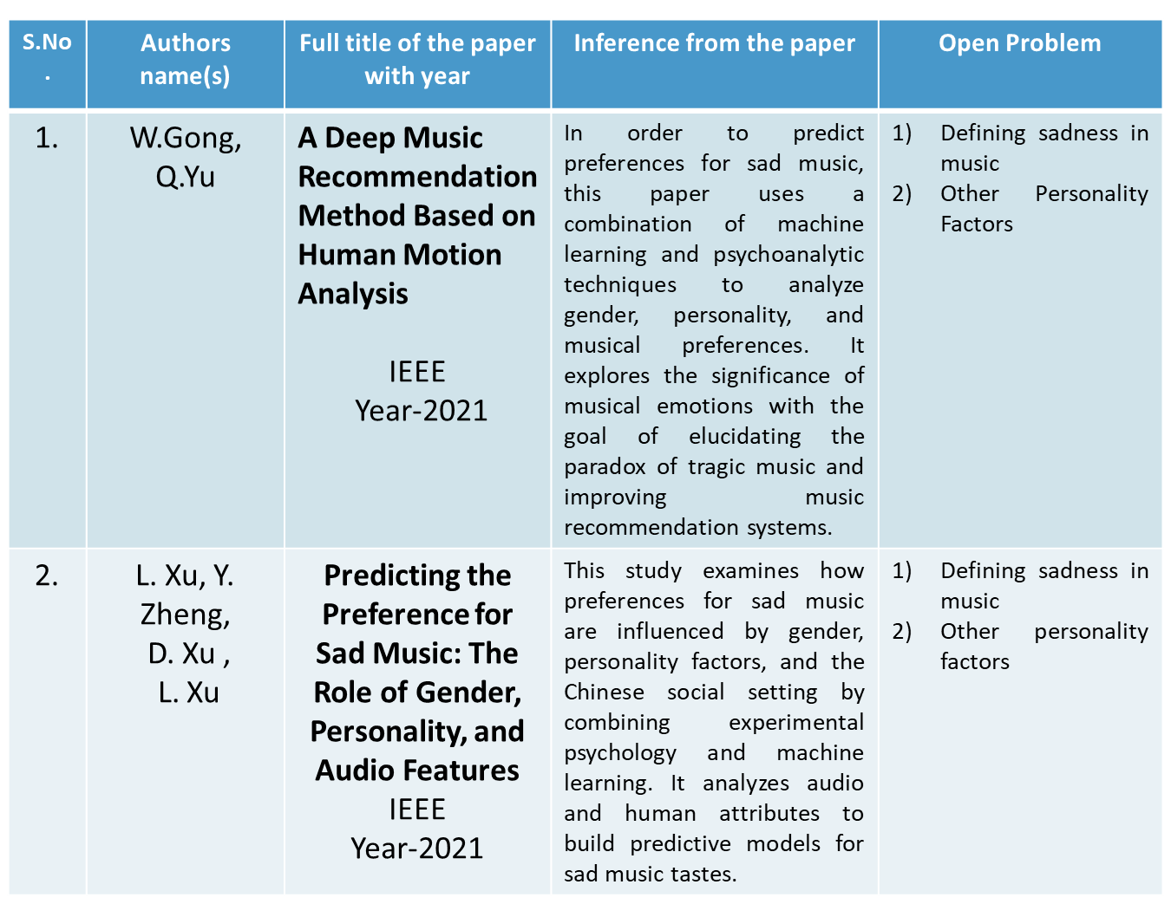





LITERATURE SURVEY

Slide 7

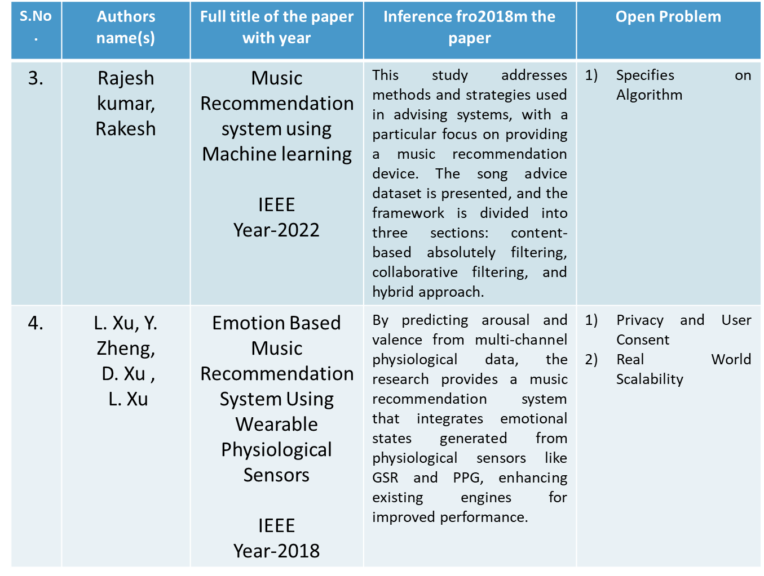



Slide 8
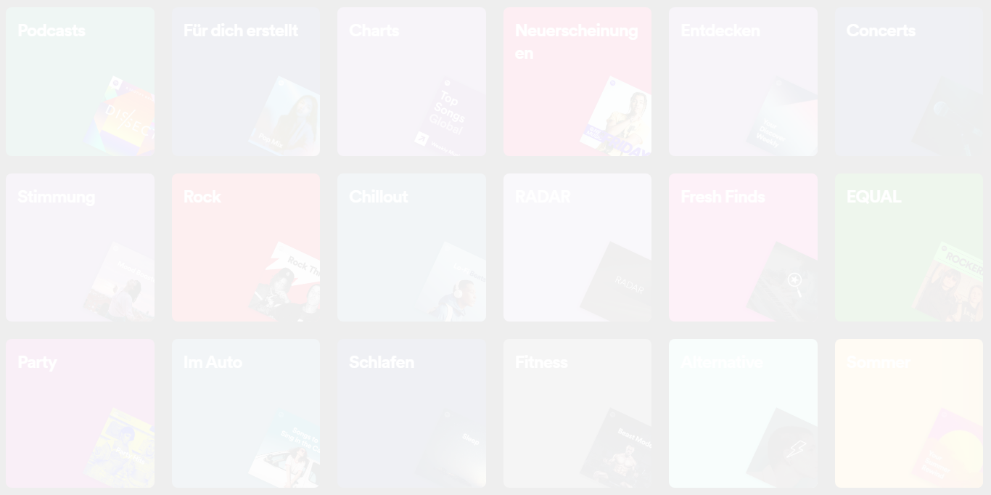




PROPOSED METHOD
We have use three algorithms in our project to enhance the performance of the music recommendation system:
K – Means clustering
LSM Algorithm
Apriori algorithm
The code uses k-means clustering. Think of it like sorting songs into different piles based on their similarities.
It also uses techniques like scaling (making sure all features are on the same scale) and visualization to better understand the data.

Slide 9


Continuation..
We have used k-mean clustering algorithm on the dataset.
K mean clustering divides the data points into k clusters.
Clusters with similar audio features like danceability, tempo, valence etc are grouped as cluster.
For best clustering we need to calculate the silhouette score.
We calculate the silhouette score for each value of k and the optimal value of k will have maximum silhouette score(s).

Slide 10
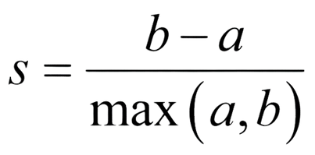



Continuation..
We then used the LSH algorithm. LSH stands for Locality-Sensitive Hashing.
It is a method for efficiently finding approximate nearest neighbors in high-dimensional spaces.
It enables quick searches in large datasets.
Nest the Apriori algorithm is used on the original dataset.
Its main purpose is to discover interesting relationships or associations among a set of items in a database.
Apriori algorithm is also used to find frequent item sets based on the selected music features.

Slide 11


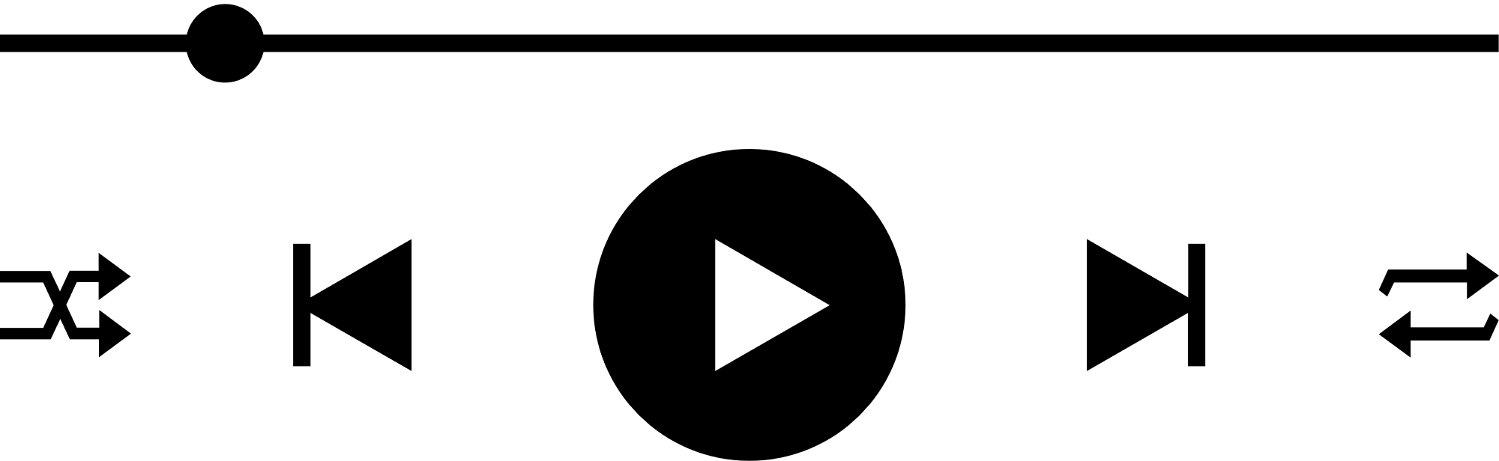
Dataset
The dataset used is called 'genres_v2.csv.' It likely contains details about songs…

Slide 12

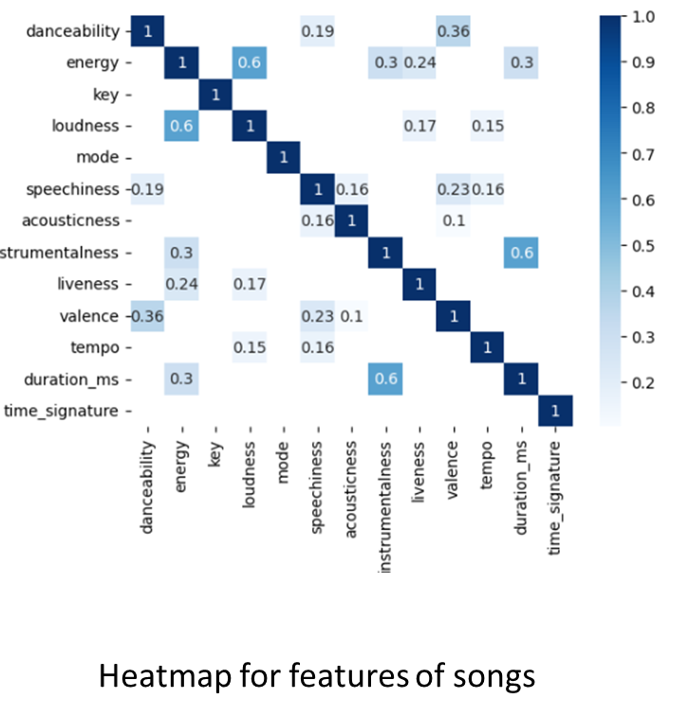

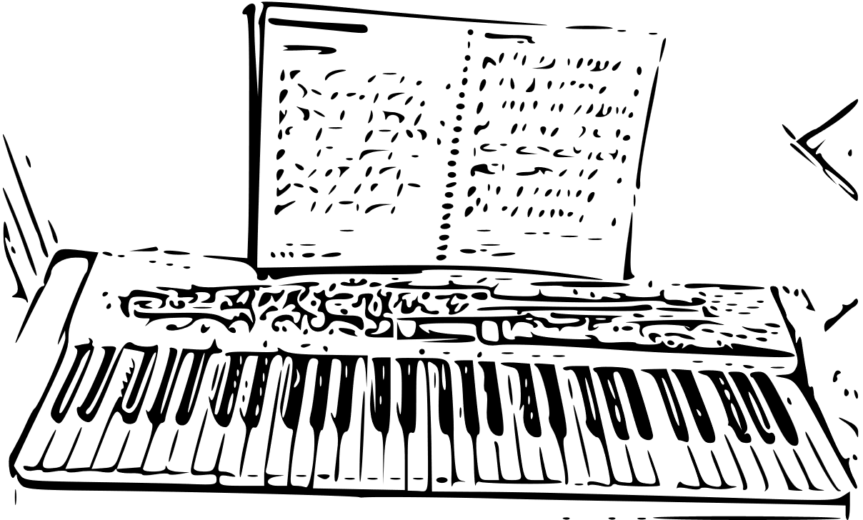

Implementation

Slide 13


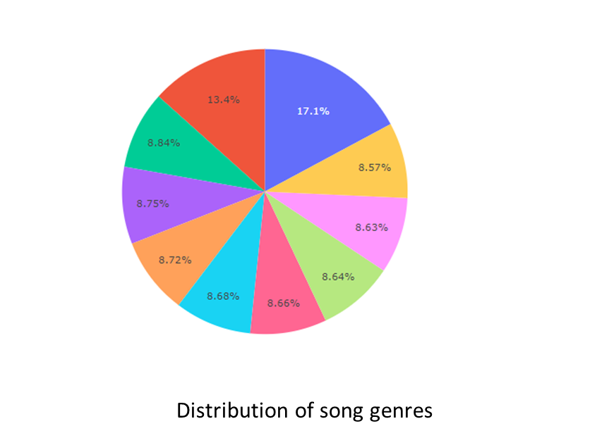


Slide 14
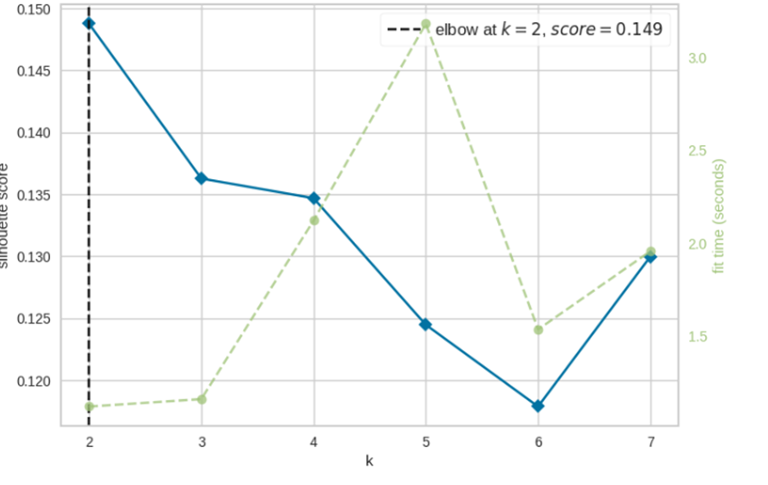
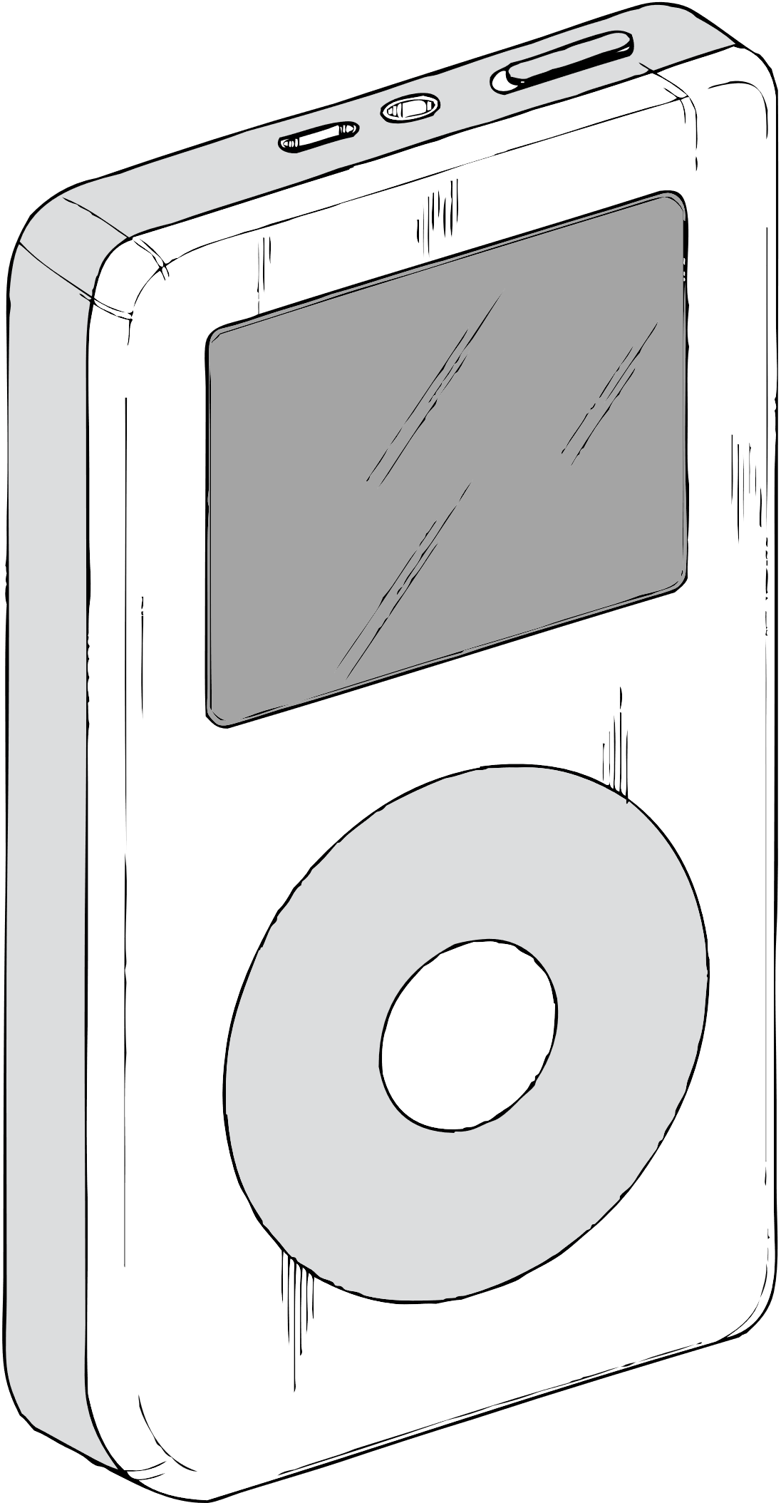
Results
Silhouette score for clustering

Slide 15
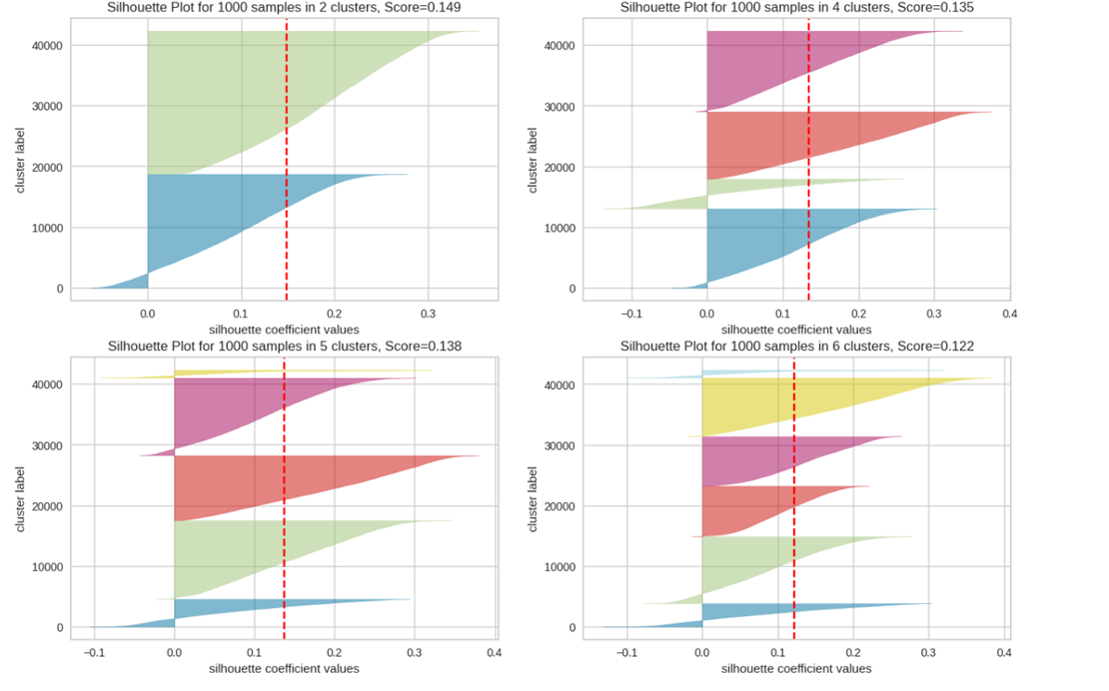
Silhoutte plot for 1000 samples in 2,3,4,6 clusters

